Slide 1

Quick Reference Parts Guide
Introduction
Main Menu
This Quick Reference Parts Guide is an easy way to locate part numbers to common replacement parts. It does not include items such as wire or their cord grips, terminal blocks, or mounting brackets. It also does not include standard hardware like nuts and bolts. To locate parts that are not covered here, refer to the drawing set in your equipment manual.
Navigating the
CD
Exit
www.mii.com
mitekparts@mii.com

Slide 2
Navigating the
Quick Reference Parts Guide
Main Menu
The next screen is the Main Menu, which has buttons to reach each category that this parts guide uses.
Each category may be further divided into different sections, each with their own button on the category’s main screen.
From each screen, you can:
  Return to the Main Menu
  Return to the category’s main page
  Go forward or backward one screen at a time within the category
  Click a link to order the part on-line or via e-mail
Exit
How to get
To the
eStore
To access a different program or file while leaving the Quick Reference Parts Guide open, hold the Alt button while pressing the Tab button on your keyboard.
www.mii.com
mitekparts@mii.com

Slide 3
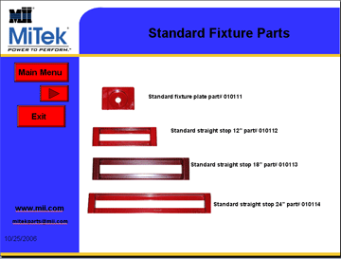

How to get to the eSTORE
Example
Once you find the part number you need, click on the web site link
www.mii.com
mitekparts@mii.com

Slide 4
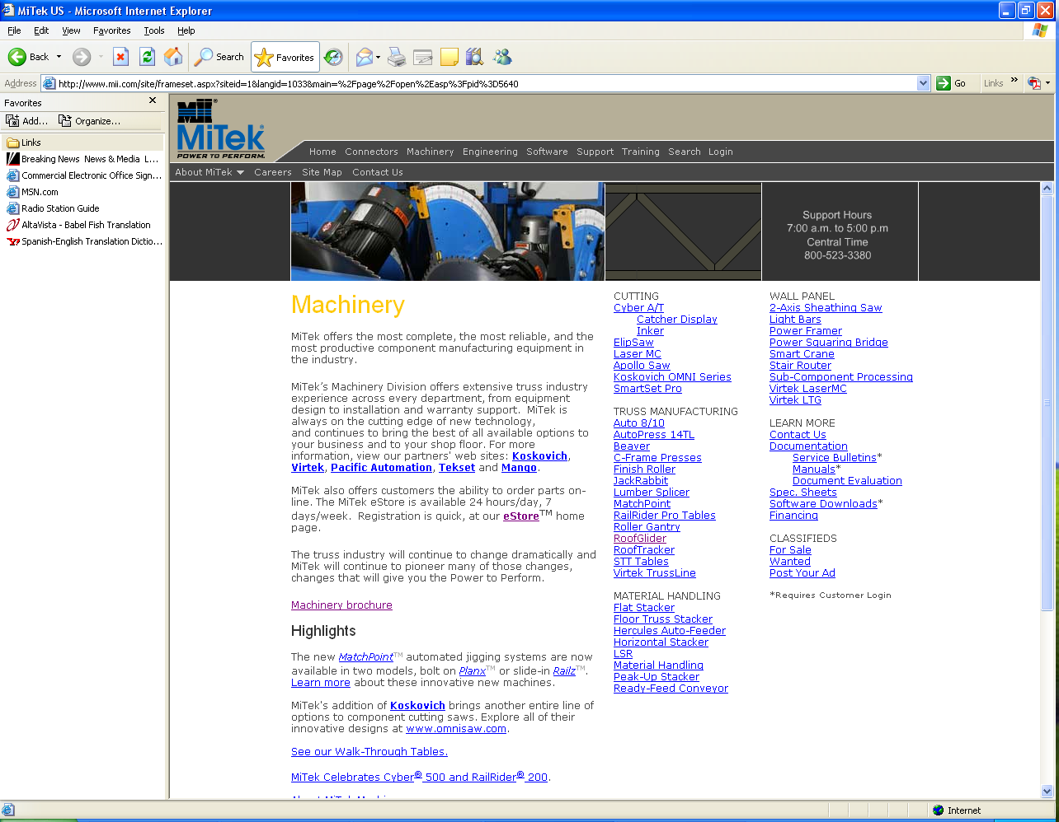
How to get to the eSTORE
www.mii.com
This is the web site, click on the machinery tab
mitekparts@mii.com

Slide 5
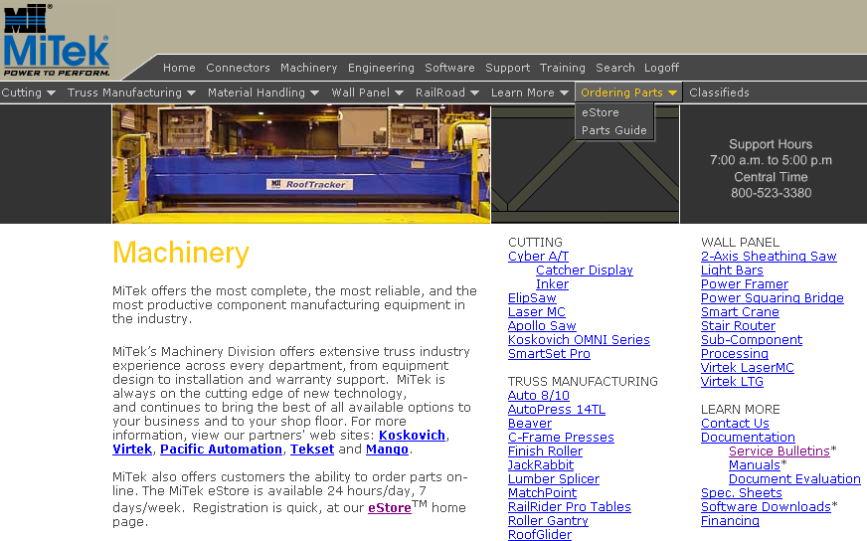
How to Get to the eStore
www.mii.com
mitekparts@mii.com
Click the Ordering Parts menu, then, click eStore.

Slide 6
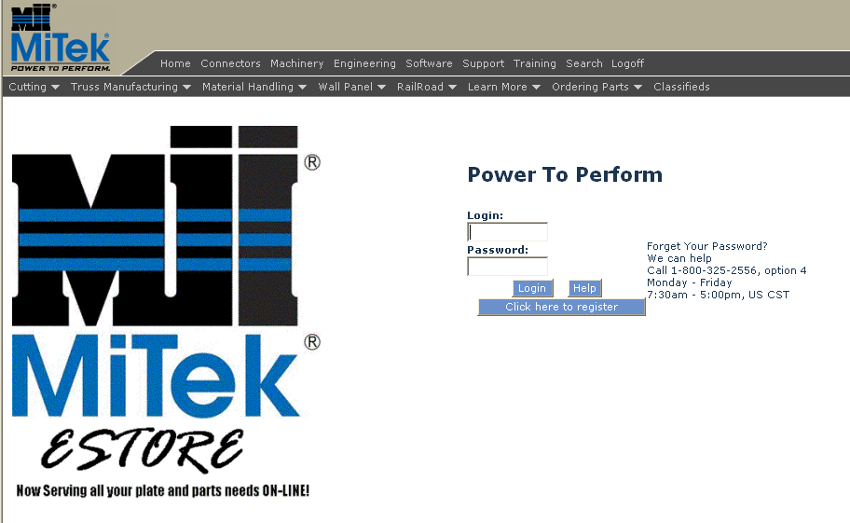
How to Get to the eStore
Main Menu
Exit
www.mii.com
Enter your eStore login and password and click Login.
If you need to register, click the Click here to register button.
mitekparts@mii.com

Slide 7
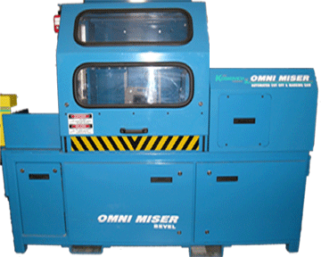
OMNI MISER II
Main Menu
Navigating the
CD
Electrical Parts Main
Mechanical Parts Main
Exit
Operator Console Main
Infeed Rail Main
Pneumatic Parts Main
www.mii.com
mitekparts@mii.com

Slide 8
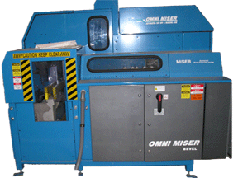
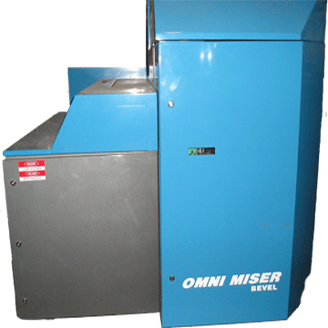
Electrical Parts
Main Menu
Main Menu
Exit
Side view
Rear view
www.mii.com
Click on the electrical box or on the
cover where the part you need is located
mitekparts@mii.com
Front view

Slide 9
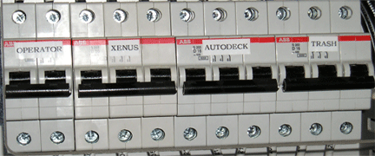
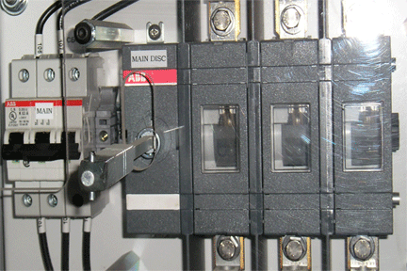
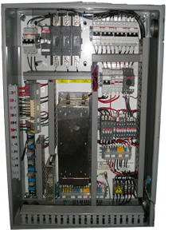
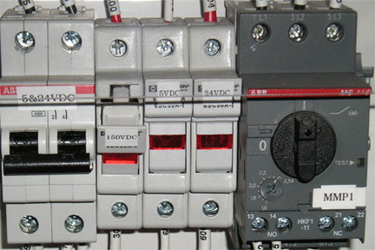
Electrical Parts
Main Menu
Part # 005-04853
Part # 005-04852
Part # 005-04854
Exit
Part # 005-01678 Breaker
Part # 005-00307
Part # 005-00306
Part # 005-04854 Breaker
Part # 005-04820 Fuse
www.mii.com
Part # 512081 Overload
mitekparts@mii.com
Part # 005-04847 Fuse
Part # 005-04846 Fuse
Contact block part# 005-01704

Slide 10
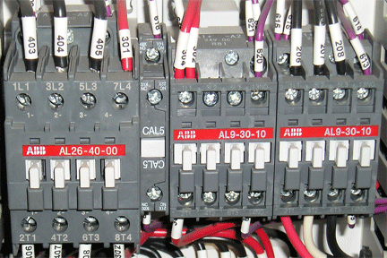
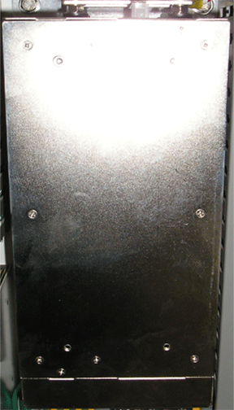
Electrical Parts
Main Menu
Part # 005-01681 Contactor
Part # 005-01680
Part # 005-01717 Contactor
Exit
Part # 519779 Power Supply
www.mii.com
mitekparts@mii.com

Slide 11
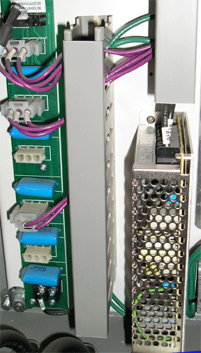
Electrical Parts
Main Menu
Exit
Part # 005-00469 Relay Card
Part # 005-00164 Power Supply
www.mii.com
mitekparts@mii.com

Slide 12
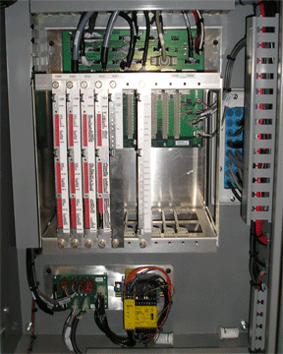
Electrical Parts
Main Menu
Part# 92227R
Part# 92226R
Part# 194650
Part#92225R
Part# 92221R
Part# 005-01616
Exit
Part# 194658
Part# 005-01687
Part# 005-01685
www.mii.com
mitekparts@mii.com

Slide 13
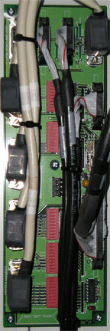
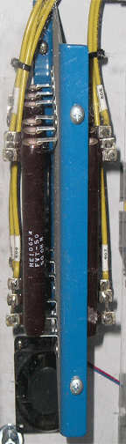
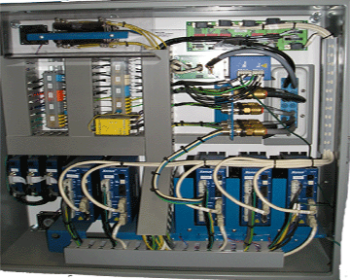
Electrical Parts
Main Menu
Part# 192657 CAC Card
Exit
Part# 005-04409
www.mii.com
mitekparts@mii.com

Slide 14
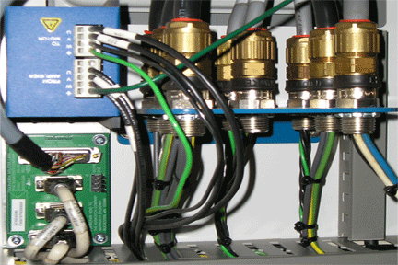
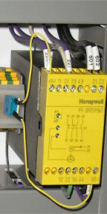
Electrical Parts
Main Menu
Part# 005-03802
Part# 194656
Exit
Part# 005-01699
Standstill Monitor
www.mii.com
mitekparts@mii.com

Slide 15
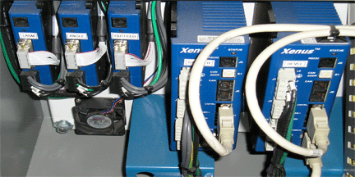
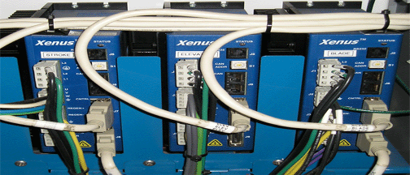
Electrical Parts
Main Menu
Part# 005-01500
Blade
Exit
Part# 005-01499
Servo Amp Only
Part# 519590
Fan
Part# 005-01496
Servo Amp Only
www.mii.com
mitekparts@mii.com

Slide 16
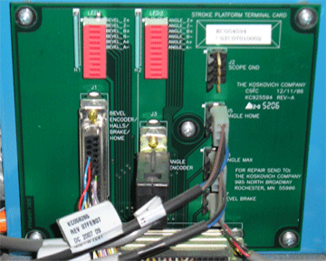
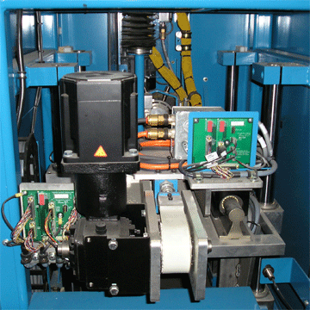
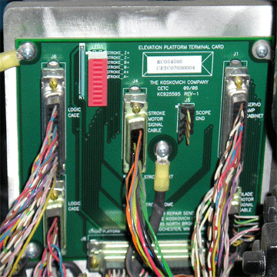
Electrical Parts
Main Menu
Part# 194652
CSTC Card
Exit
Part# 194653
CETC Card
www.mii.com
mitekparts@mii.com

Slide 17
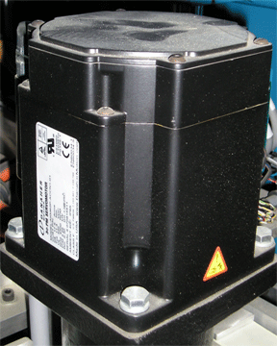
Electrical Parts
Main Menu
Exit
Part # 005-02172
Stroke Motor
www.mii.com
mitekparts@mii.com

Slide 18
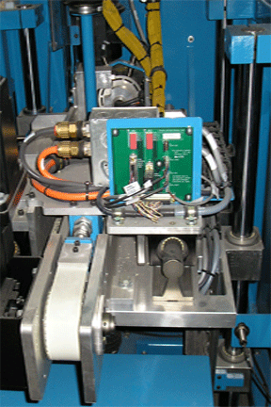
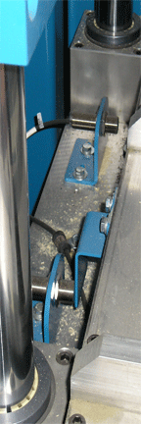
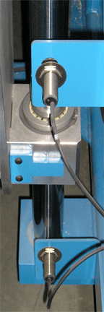
Electrical Parts
Main Menu
Part # 97037-501
Part # 97036-501
Exit
Part # 97012-501
www.mii.com
Part # 97011-501
mitekparts@mii.com

Slide 19
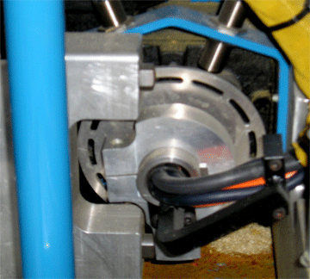
Electrical Parts
Main Menu
Exit
Part # 97034-501
Angle Home Sensor
Part # 97035-501
Angle Max Sensor
www.mii.com
mitekparts@mii.com

Slide 20
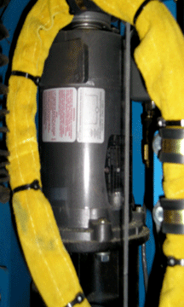

Electrical Parts
Main Menu
Exit
Part # 97078-501
Angle Encoder
Part # 005-00026
Angle Motor
www.mii.com
mitekparts@mii.com

Slide 21
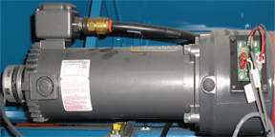
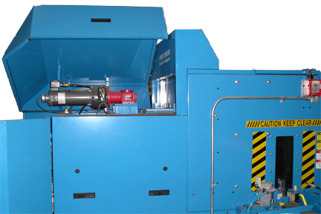
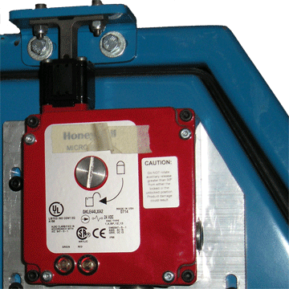
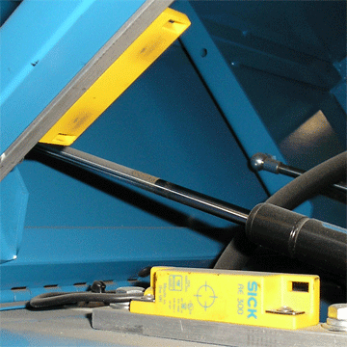
Electrical Parts
Main Menu
Exit
Part # 005-00019
Elev. Motor
Part # 97078-501
Encoder
Part # 005-03169
Elev. Brake
Switch only part# 005-01700
Switch assembly part# 005-01975
Includes conduit and cabling
www.mii.com
mitekparts@mii.com
Part# 504663
Door Switch

Slide 22
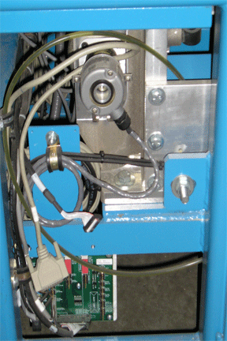
Electrical Parts
Main Menu
Part # 97078-501
LASM Encoder
Exit
Part# 194649
CTRM Card
www.mii.com
mitekparts@mii.com

Slide 23
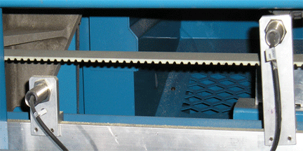
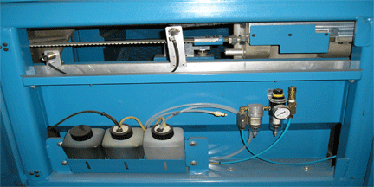
Electrical Parts
Main Menu
Part # 97013-501
Lockout Prox
Exit
Part # 97020-501
LASM Max Sensor
www.mii.com
mitekparts@mii.com

Slide 24
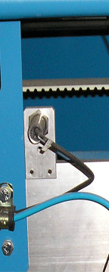
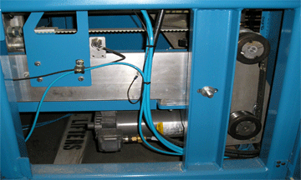
Electrical Parts
Main Menu
Exit
Part # 97019-501
LASM Home Sensor
www.mii.com
mitekparts@mii.com

Slide 25
Electrical Parts
Main Menu
Exit
Part # 005-00019
LASM Motor
www.mii.com
mitekparts@mii.com

Slide 26
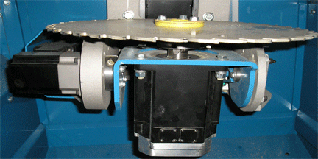
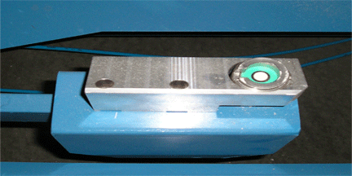
Electrical Parts
Main Menu
Exit
Prox switch Part# 97022-501
Part # 005-02183
Blade Motor
Part # 005-01693
CLS Sensor
www.mii.com
mitekparts@mii.com

Slide 27
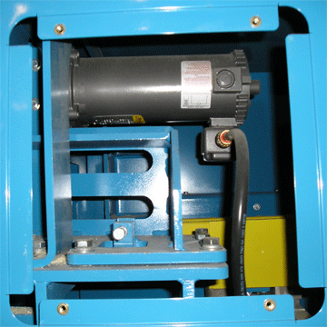
Electrical Parts
Main Menu
Part # 005-00019
Outfeed Motor
Exit
www.mii.com
mitekparts@mii.com

Slide 28
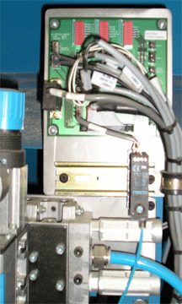
Electrical Parts
Main Menu
Part# 194649
CTRM Card
Exit
Part # 005-01653
Air Pressure Sensor
www.mii.com
mitekparts@mii.com

Slide 29
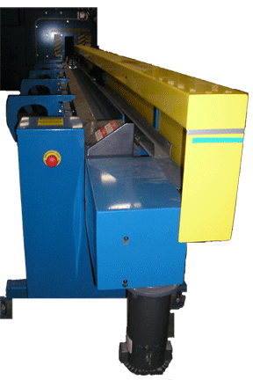
Infeed Rail Main
Main Menu
Inker End Electrical Parts
Exit
Driven End Electrical Parts
www.mii.com
mitekparts@mii.com

Slide 30
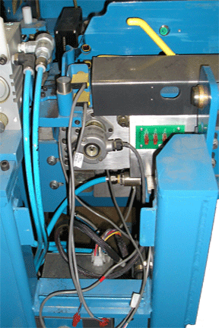
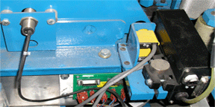
Inker End Electrical Parts
Main Menu
Part # 97075-501
PE Emitter
Exit
Part # 97078-501
Gripper Encoder
Rear view
Part # 97074-501
PE Receiver
www.mii.com
mitekparts@mii.com
Front view
Part # 97071-501 Gripper Min sensor
Part # 194641
MPE Card

Slide 31


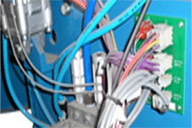
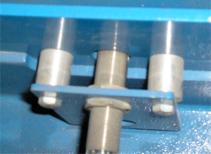
Driven End Electrical Parts
Main Menu
Part # 511536
X 3
Exit
Part # 511532
Part # 005-01606
M2EC
www.mii.com
mitekparts@mii.com
Part # 97071-501
Gripper Home Sensor

Slide 32
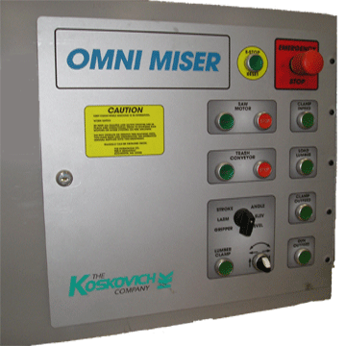
Operator Console Main
Main Menu
Exit
Click on the switch
needed
www.mii.com
mitekparts@mii.com
PC, Monitor and Keyboard

Slide 33


Operator Console
Main Menu
Part # 511532
Exit
Part # 511536
X 3
www.mii.com
mitekparts@mii.com

Slide 34


Operator Console
Main Menu
Part # 005-00391
Exit
Part # 511534
Part # 511533
www.mii.com
mitekparts@mii.com

Slide 35


Operator Console
Main Menu
Part # 005-00337
Exit
Part # 511534
www.mii.com
mitekparts@mii.com

Slide 36

Operator Console
Main Menu
Part # 005-00337
Exit
Part # 511534
www.mii.com
mitekparts@mii.com

Slide 37

Operator Console
Main Menu
Exit
Part # 005-00337
Part # 511534
www.mii.com
mitekparts@mii.com

Slide 38

Operator Console
Main Menu
Exit
Part # 005-00337
Part # 511534
www.mii.com
mitekparts@mii.com

Slide 39


Operator Console
Main Menu
Exit
Part # 005-00339
Part # 005-00391
Part # 511536
Part # 511536
www.mii.com
mitekparts@mii.com
Part # 511534
Part # 511533

Slide 40


Operator Console
Main Menu
Part # 005-00339
Exit
Part # 005-00391
Part # 511533
Part # 511536
www.mii.com
mitekparts@mii.com
Part # 511534

Slide 41



Operator Console
Main Menu
Part # 511538
assembly
Exit
Part # 511539
Part # 511534
www.mii.com
Part # 005-00337
mitekparts@mii.com
Part # 511534

Slide 42


Operator Console
Main Menu
Exit
Part # 504692 PC
Part # 005-03762
Com Card
Part # 005-03764
I/O Card
Monitor Not Shown
www.mii.com
Part # 504567
mitekparts@mii.com

Slide 43

Pneumatic Parts Main
Main Menu
Exit
Click on the cover where the part you need is located
www.mii.com
mitekparts@mii.com

Slide 44


Pneumatic Parts
Main Menu
Exit
Part # 005-03506
Air Dump
Part # 005-03502
Regulator
Part # 005-03505
Air Shut Off
Part # 005-03426 Regulator
Part # 005-03425
Gage
Part # 005-01653 Air
Pressure Sensor
www.mii.com
Part # 005-01655 Coil
mitekparts@mii.com
Part # 005-03417 Valve
Part # 005-03508
Exhaust Muffler

Slide 45

Pneumatic Parts
Main Menu
Part # 005-04462
Relief Valve
Exit
Part # 005-04461
Regulator Assy
Complete Assembly #005-04461
www.mii.com
mitekparts@mii.com

Slide 46

Pneumatic Parts
Main Menu
Exit
Part # 005-03386
Cylinder
Part # 97072-501
Festo Sensor
Part # 005-03508
Exhaust Muffler
Part # 005-03417 Valve
www.mii.com
Part # 005-01655
Coil
mitekparts@mii.com

Slide 47

Pneumatic Parts
Main Menu
Exit
Part # 005-00129 64 mm Print Head
Part # 005-03472
Exhaust Valve
www.mii.com
mitekparts@mii.com
Part # 005-03463
Cylinder

Slide 48

Pneumatic Parts
Main Menu
Part # 005-03422 Fitting
Part # 005-03392
Bulkhead Fitting
Exit
Part # 005-03394
Fitting
www.mii.com
Part # 005-06099
Cylinder
Part # 005-06104
Sensor Assembly
mitekparts@mii.com

Slide 49

Pneumatic Parts
Main Menu
Exit
Air cylinder # 85448
www.mii.com
mitekparts@mii.com

Slide 50


Pneumatic Parts
Main Menu
Part # 005-06118 Hold Down Cylinder
Exit
Part # 005-03463 Air Cylinder
www.mii.com
mitekparts@mii.com

Slide 51
Mechanical Parts Main
Main Menu
Exit
Click on the cover where the part you need is located
www.mii.com
mitekparts@mii.com

Slide 52


Mechanical Parts
Main Menu
Exit
Part #005-03172 Outfeed Side X3
Part #005-03173 Infeed Side X3
Part #416145 Outfeed Side
Part #005-02955 Infeed Side
www.mii.com
mitekparts@mii.com

Slide 53


Mechanical Parts
Main Menu
Exit
Part # 005-03165
Screw Jack
Part # 480276
Stroke Gearbox
www.mii.com
mitekparts@mii.com

Slide 54


Mechanical Parts
Main Menu
Part # 005-02475 Bearing
Exit
Part # 005-03255
Belt
Part # 85645 Shaft
www.mii.com
mitekparts@mii.com
Part # 005-02475 Bearing
Part # 005-02474 Bearing

Slide 55

Mechanical Parts
Main Menu
Exit
www.mii.com
Angle Gearbox #005-02962
mitekparts@mii.com

Slide 56

Mechanical Parts
Main Menu
Exit
Part # 005-00010
Gas Shock
www.mii.com
mitekparts@mii.com

Slide 57
Mechanical Parts
Main Menu
Part # 005-02979 Gearbox
Exit
Part # 005-03262 Clutch
Part # 85321 Steel Roller
Part # 85231 Roller
Part # 005-02976 Bearing
www.mii.com
mitekparts@mii.com

Slide 58
Mechanical Parts
Main Menu
Exit
Part # 005-03370
Fixed Jaw
Part # 005-03371
Floating Jaw
www.mii.com
mitekparts@mii.com

Slide 59



Mechanical Parts
Main Menu
Exit
Part # 005-00010
Gas Shock
Part # 005-03097 LASM Bearing 4PK
www.mii.com
mitekparts@mii.com

Slide 60


Mechanical Parts
Main Menu
Part #005-02972
Exit
Part #005-03082 Drive end Kit
Part #005-02555 Pulley
Part #005-02972 Belt
www.mii.com
mitekparts@mii.com
Part #005-02555 Pulley

Slide 61

Mechanical Parts
Main Menu
Part #005-02972 LASM Belt
Exit
Part #005-03081 Idle End Kit
Infeed Side
www.mii.com
mitekparts@mii.com

Slide 62



Mechanical Parts
Main Menu
Part # 005-03081 Idler End Kit
Exit
Part # 005-03081 Drive End Kit
Part #005-02806
Part #005-02505 16 FT
005-02506 18 FT
005-02994 20 FT
www.mii.com
Part #005-02560 Gripper V-Belt
mitekparts@mii.com
Part #005-02555
Pulley

Slide 63
Mechanical Parts
Main Menu
Exit
For use later
www.mii.com
mitekparts@mii.com

Slide 64
Mechanical Parts
Main Menu
Exit
For use later
www.mii.com
mitekparts@mii.com

